Slide 1

Object Detection
Landmark detection
deeplearning.ai

Slide 2
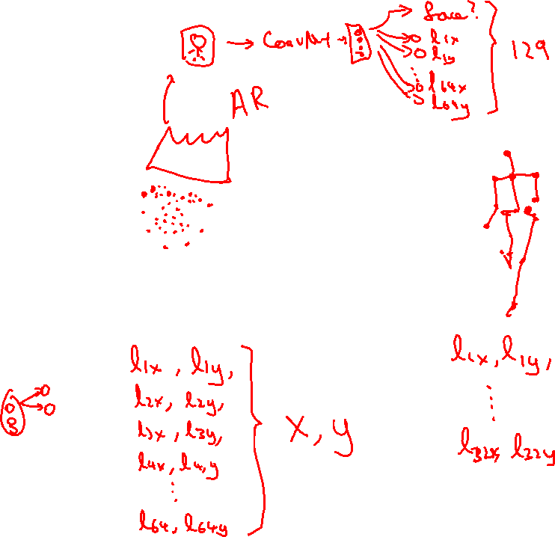
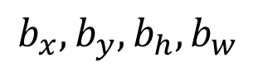
Landmark detection
ConvNet
$$b_{x},b_{y},b_{h}, b_{w}$$

